Slide 1
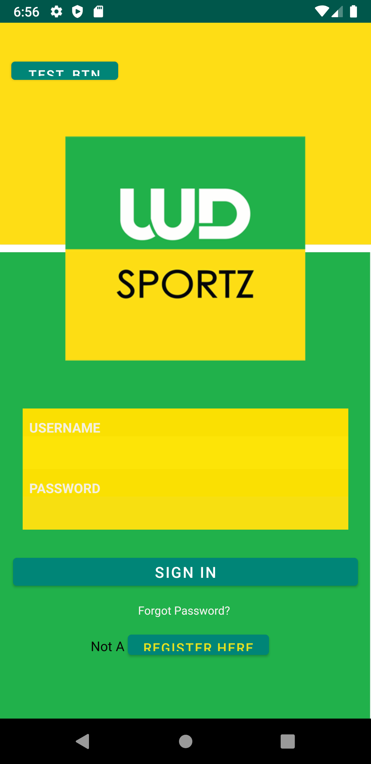

WD SPORTZ APP
Making all levels of sports matter

Slide 2
Why a WD Sportz APP
More than 50% of videos are watched on mobile
Millennials’ mobile consumption has now eclipsed their live TV consumption
94% of respondents in a Facebook survey (of one million people) have a smartphone on hand while watching TV, and viewers focus on the TV screen just 53% of the time

Slide 3
Meet your App

Slide 4
The Features
Enables users the ability to view new articles.
Enables users to Watch live matches, highlights and WD Sportz episodes.
Enables users to view past league results.
Allows users to personalize their profile to reflect their profiles.

Slide 5
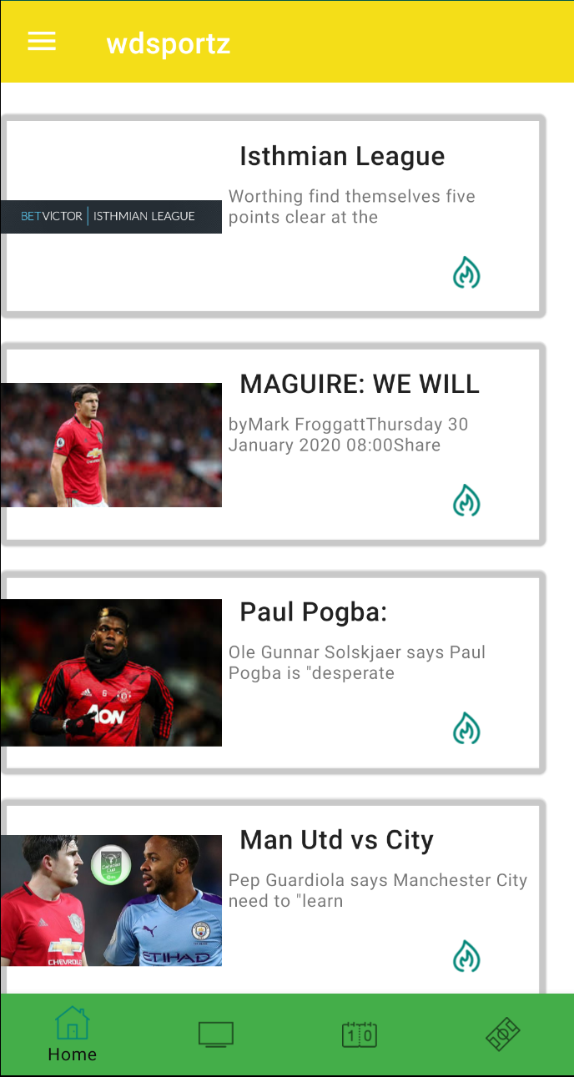
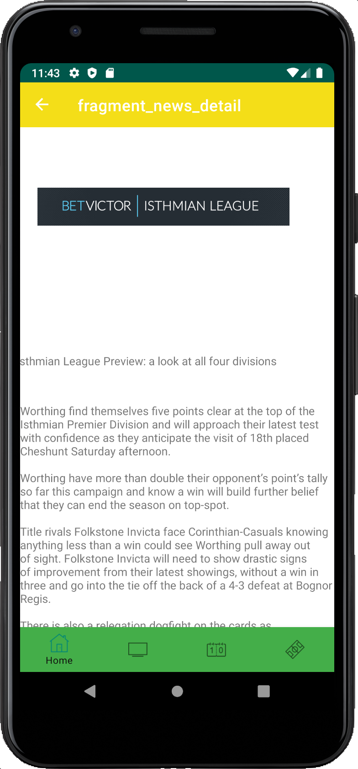
News
Allows Users to view news articles or blogs.
Users can make comments on news they see.

Slide 6
Watch
Allows users to watch live matches that you are showing.
Users can also view league highlights alongside all other content you produce.

Slide 7
Scores
Users can view past match results from the different leagues you cover.
This is done autonomously therefore you do not have to worry about the collection of the data.

Slide 8
More…
Users can personalize their profile to suit their personal preference.
Users can also view the WD Sportz site if they wish.

Slide 9
Deployment
Someone to upload news to the database for the app.
Someone to upload videos to the database for users to see.
Someone that may need to respond to users that choose to contact us regarding issues like the deletion of their account.
People that would like to support the testing of the app very soon to enable us to publish it just before the league starts. The testers must have an Android phone.
New roles may arise in the future.

Slide 10

Meet the Developers
Khrishawn Powell
Ore Yusuf

Slide 11
Questions?

